Slide 1
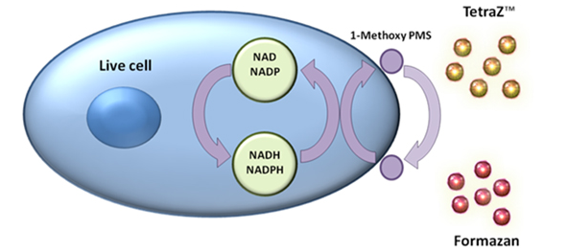
TetraZ™ Cell Counting Kit
TetraZ™ is a reagent based on tetrazolium salts that can be used to study cell proliferation or viability.
1-Methoxy PMS is an electron mediator and transfers an electron between NADH/NADPH and TetraZ™.
1
TetraZ™ is reduced to formazan after acceptance of an electron from live cells.
2
Formazan is a dye and its optical density can be read on a plate reader. The number of live cells is proportional to amount of formazan in each well.
3
®

