Slide 1
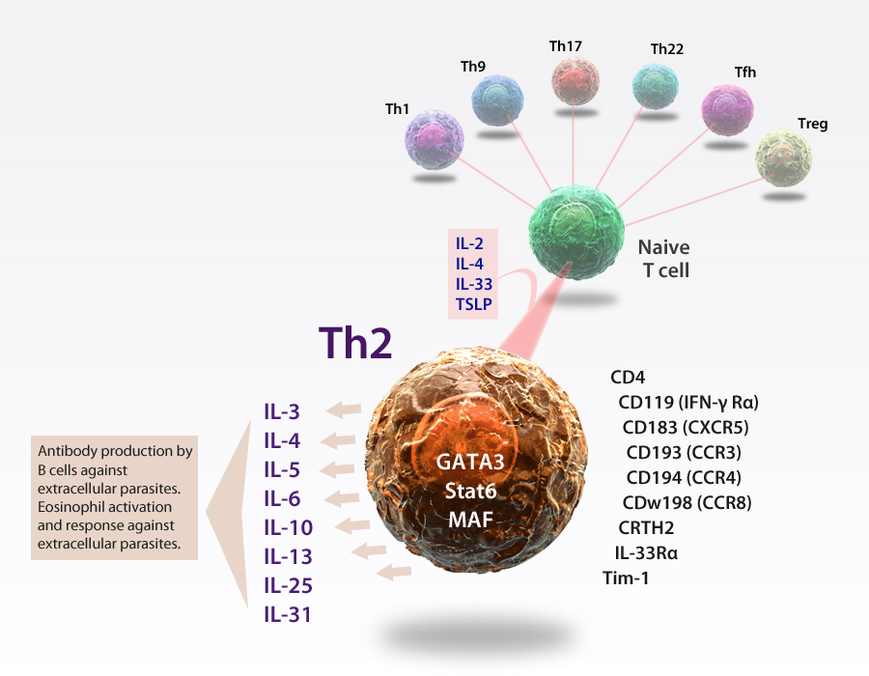
Th2 Cells
Th2 cells are IL-4 polarized T helper cells that stimulate the humoral response to infections, including B cell proliferation, class-switching, and increased antibody production. Th2 cells are characterized by the expression of the transcription factor GATA3 and produce cytokines: IL-4, IL-5, IL-6, IL-10, and IL-13. Th2 cells are associated with several inflammatory conditions, including allergy and asthma.
®

