Slide 1
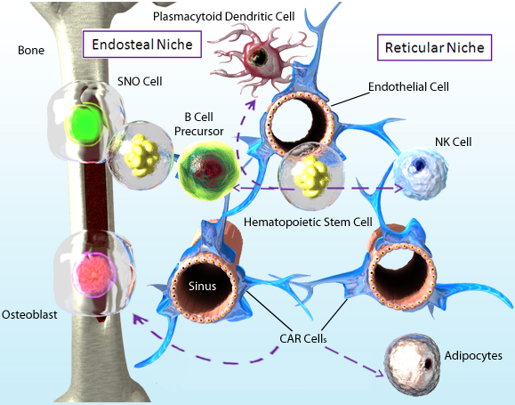
Bone Marrow Niche Development of Hematopoietic Stem Cells
Hematopoietic Stem Cells (HSCs) are capable of developing into any blood cell lineage. They develop in the bone marrow.
A small percentage of HSCs interacted with the endosteal niche, SNO cells, and osteoblasts.
A majority of HSCs were sustained by the Reticular Niche, its CAR cells (see notes), and factors like CXCL12 and SCF.
Adapted from: Sugiyama, T. and Nagasawa, T. 2012. Inflamm. Allergy Drug Targets. 11:201.
®
Notes:
SNO cells: Spindle-shaped N-cadherin⁺CD45⁻ cells
CAR cells: CXCL12-Abundant Reticular cells
SCF: Stem cell factor
CAR cells are a major source of CXCL12 and SCF. They can also differentiate into osteoblasts or adipocytes.

