Slide 1
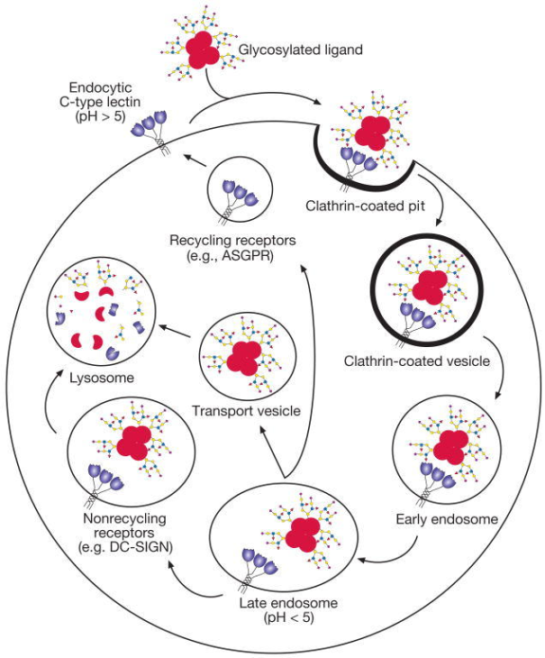
CLECs CD206 & CD209
Overall, there are 17 different families of CLECs
CD206 (Mannose Receptor) is a CLEC found mainly found on Dendritic Cells (DCs) and Macrophages. It is involved in antigen processing and presentation, cell migration, and intracellular signaling.
CD209 (DC-SIGN) is another CLEC that aids DC migration and T cell stimulation.
Both of these CLECs:
Bind microbial-specific carbohydrates like mannose, fucose, or N-acetyl glucosamine
Are involved with internalization of microbes
May play a role as an entry point for HIV.
®

